Slide 1
Linear and Circular Races

Slide 2
Linear and Circular Races
Introduction
Problems with races on linear tracks: head start and dead heat finish, head start and early finish, head start and late finish
Problems on circular track: first meeting point, meeting at starting point and number of meetings
Data Sufficiency

Slide 3
LINEAR RACES
Commonly used expressions in linear races
Expression | Meaning
Head-Start / A gives B start of x meters | When a racer gets a start x meters ahead of the starting point it’s called head-start of x meters. Here A gives B a head-start of x meters.
Head-Start/ A can give B a start of t minutes | When a contestant gets a start by t seconds earlier than other ones, it’s called head-start of t seconds. Here A gives B a head-start of t seconds.
A beats B by x meters | When A reaches the winning point before B and is x meters away from B. Then A beats B by x meters.
A beats B by t seconds | When A reaches the winning point t seconds before B. Then A beats B by t meters.
Dead Heat | A dead heat is a situation of tie. When all the participants reach the winning point at the same point.

Slide 4
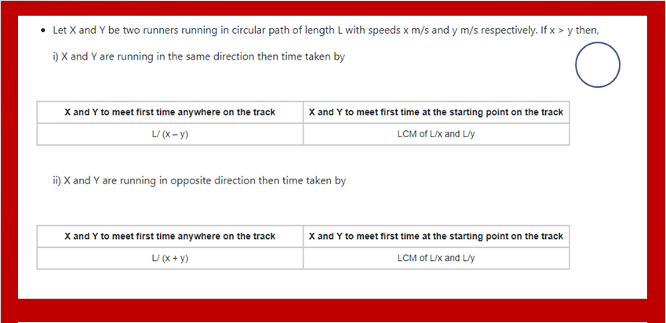
CIRCULAR RACE CONCEPT

Slide 5
1. In a race of 1500m, H beats Q by 195 m or 15 seconds. Find Q’s speed
A. 5 B. 10 C. 13 D. 20
Notes:
Difficulty Level : Easy (compulsory)
C

Slide 6
2. In a 400 m race, A can give B 30 m and C 50 m start . In the same race B can give to C a start of(approx)
A.21m B.28m C.30m D.40m
Notes:
Difficulty Level : Easy (compulsory)
A

Slide 7
3. A and B take part in 500 m race. A runs at 10 m/s. A beats B by 5 seconds. The speed of B is:
A. 9.09 m/s B.11 m/s C.12.12m/s D.1.8m/s
Notes:
Difficulty Level : Easy (compulsory)
A

Slide 8
4. A runs 3 times as fast as B. If A gives B a start of 45 m, how far must the winning post be so that A win by 15 meter?
A.80m B.120m C.135m D. None
Notes:
Difficulty Level : medium (compulsory)
D

Slide 9
5. In 720 meters race J got a head start of 30 meters. If S beats J by 50 meters find the ratio of the speeds of S and J?
A. 4:9 B. 9:4 C. 9:8 D. 2:3
Notes:
Difficulty Level : medium (compulsory)
C

Slide 10
6. In a 1800 m race, the ratio of the speeds of two contestants W and F is 7: 9. W has a start of 330 m. Then, F wins by?
A.50 B.90 C.150 D. 200
Notes:
Difficulty Level : medium (compulsory)
B

Slide 11
7. In a 1000m race, the ratio of speeds of two runners X and Y is 4:5.X has a start of 200m. Who wins the race and what is the distance between X and Y at the finish of the race?
A.X, 100m B.Y, 200m C.X, 200m
D. Both finished at the same time
Notes:
Difficulty Level : Expert (optional)
D

Slide 12
8. Uma and Rita run a 5 kilometre race on a round course of 250 metres. If their speeds be in the ratio 5:4 how often does the winner pass the other?
A. 1.5Times B.2.5Times C.3Times D.4 times
Notes:
Difficulty Level : Expert (compulsory)
D

Slide 13
9. In a 1000m race, P beats Q by 100m. Q beats R by 50m in a 500m race If P beats R by 60 seconds in 2000m race, how long would car Q take to travel a distance of 3000m?
A. 400 B.416 C.456 D. None
Notes:
Difficulty Level : Expert (compulsory)
D

Slide 14
10. While A can make 8 round of a track, B can make 5 rounds of track. If both of them start the race from same point in same directions, then the number of distinct meeting points are
A. 40 B. 13 C. 3 D. 5
Notes:
Difficulty Level : medium (compulsory)
C

Slide 15
11. Three runners participated in a Circular Race, completes the race in 12 sec, 15 sec and 20 sec respectively. if all the three starts at the same time and the same point then find when all will meet at the first time at starting point?
A.120sec B.80sec C.60sec D.160sec
Notes:
Difficulty Level : medium (compulsory)
C

Slide 16
12. Raju, Ketan and Ritu run around a circular track of length 2400 m with respective speeds 9, 18, 27 kmph. If they started at the same time from the same point and run in the same direction when will they meet for the first time? A.360 sec B.480 sec C.960 sec D. None
Notes:
Difficulty Level : medium (compulsory)
C
L = 2400 m Speed of A (a) = 9 x 5/18 = 2.5 m/sec Speed of B (b) = 18 x 5/18 = 5 m/sec Speed of C (c) = 27 x 5/18 = 7.5 m/sec They will meet for the first time at a time which is the La−b,Lb−c seconds La−b = 2400 / 5−2.5 = 960 sec Lb−c = 2400 / 7.5−5 = 960 sec So they will meet for the first time after 9600 sec. i.e., 16 min after they start.

